Slide 1
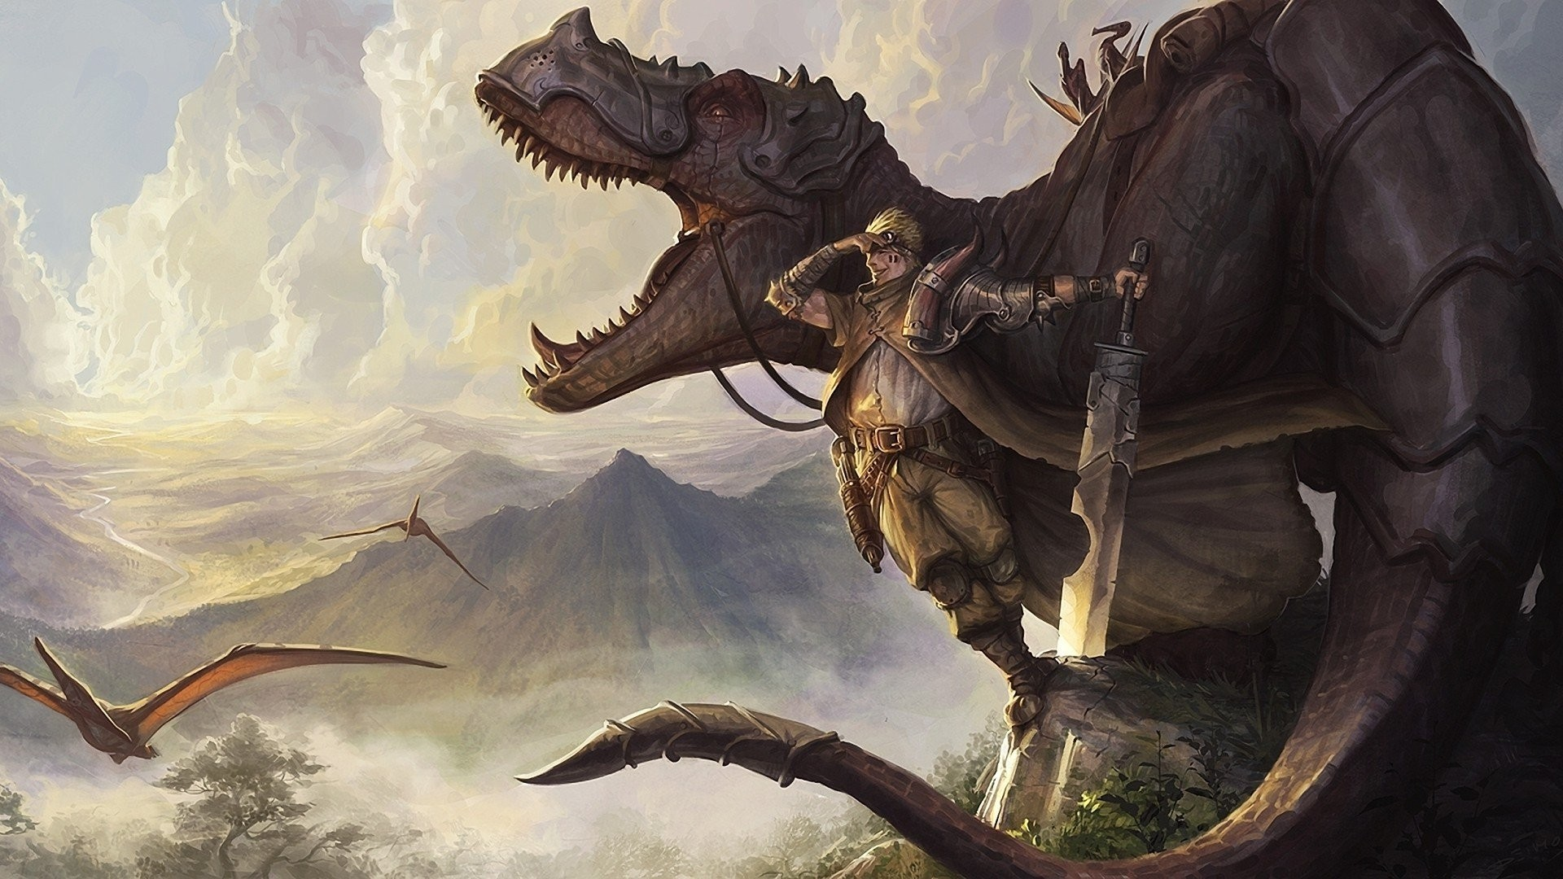
MY PORTFOLIO
Made By: Aayush C Katare
Std Div: IX-F Roll No: 02
Date: 17-02-2024

Slide 2
INDEX
Sl No. | Topic | Pg No.
1 | Myself | 1-2
2 | My School | 3
3 | My Principal | 4
4 | My Class Teacher | 5
5 | My Subject Teachers | 6-12
6 | My Class | 13
7 | My Parents | 14
8 | My Sister | 15
9 | My Friends and Classmates | 16
10 | My Ambition/Career | 17
11 | My Role Model | 18
12 | Participation in Activities/ Competitions | 19
13 | Achievements | 20
14 | School Picnic | 21
15 | Subject I like Best and Reason | 22

Slide 3

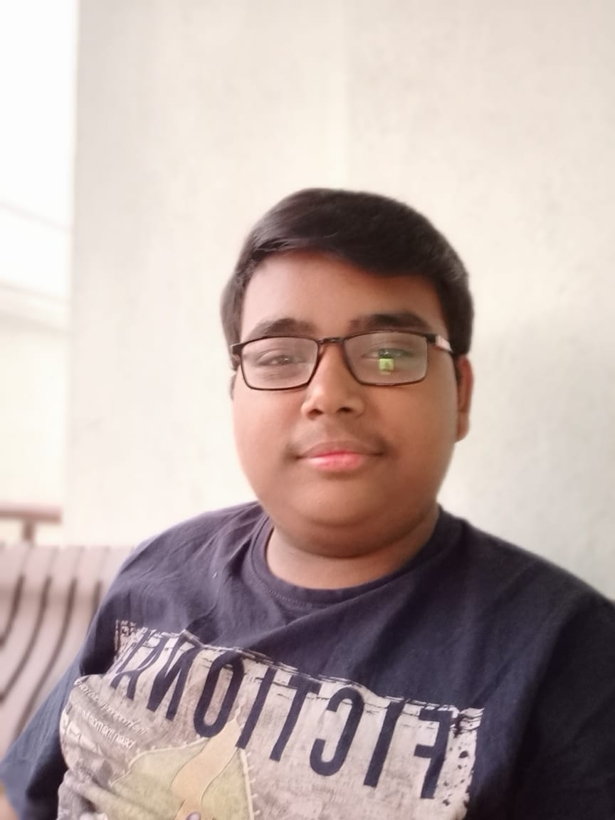
MY SELF
Aayush Katare IX-F

Slide 4
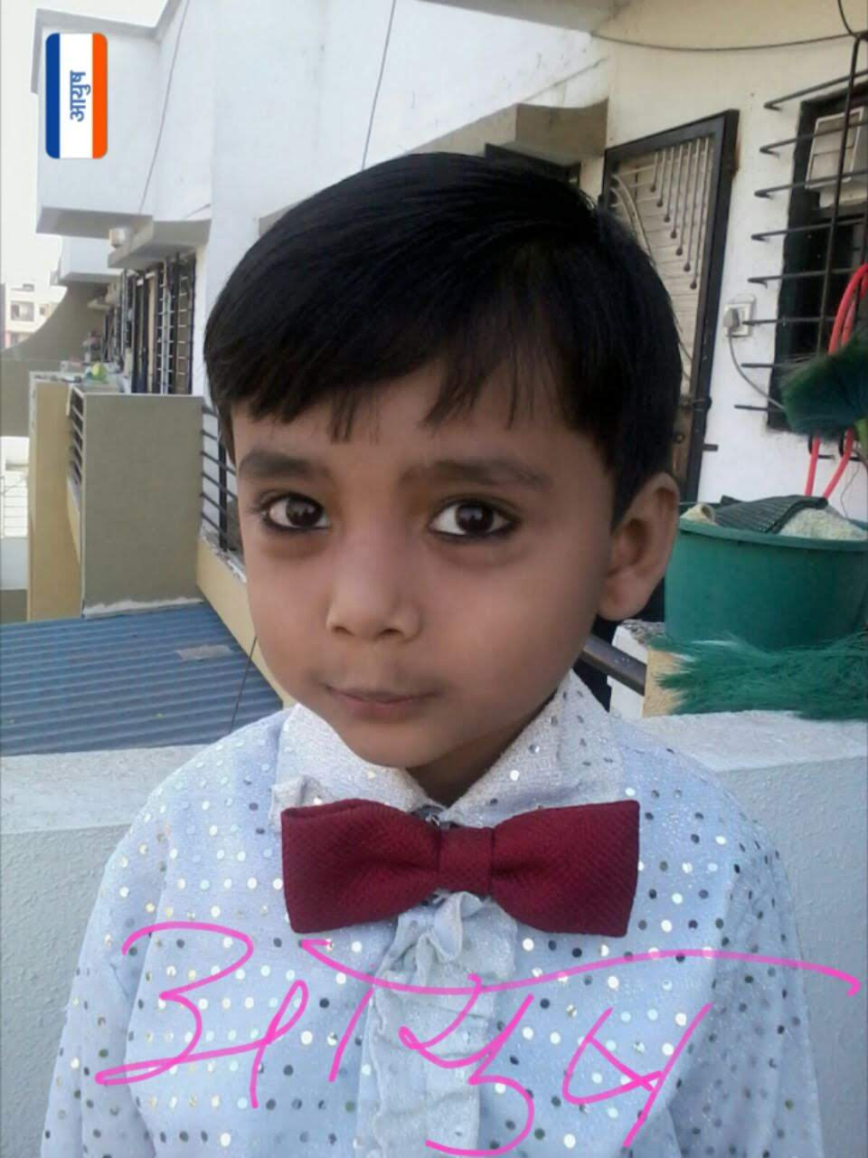
Childhood Photo

Slide 5
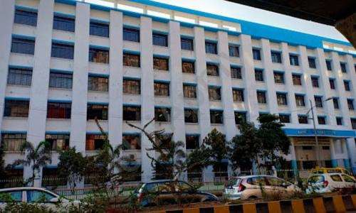
MY SCHOOL
Ramsheth Thakur Public School is
located in Kharghar, Raigad. 88 dedicated
and professional teachers ensure that the
children get the maximum out of their
eduaction in this CBSE school. In 2009,
Ramsheth Thakur Public School was
launched. English is the primary medium
of instruction for this school and the
student teacher ratio is 27:1. Navi
Mumbai: Ramsheth Thakur Public
School at Kharghar of Janardan Bhagat
Shikshan Prasarak Sanstha has emerged
as the cleanest school in the country. This
is the only school in Raigad district and
Navi Mumbai to receive the 'Swachh
Vidyalaya Puraskar’ from the Government
of India.

Slide 6
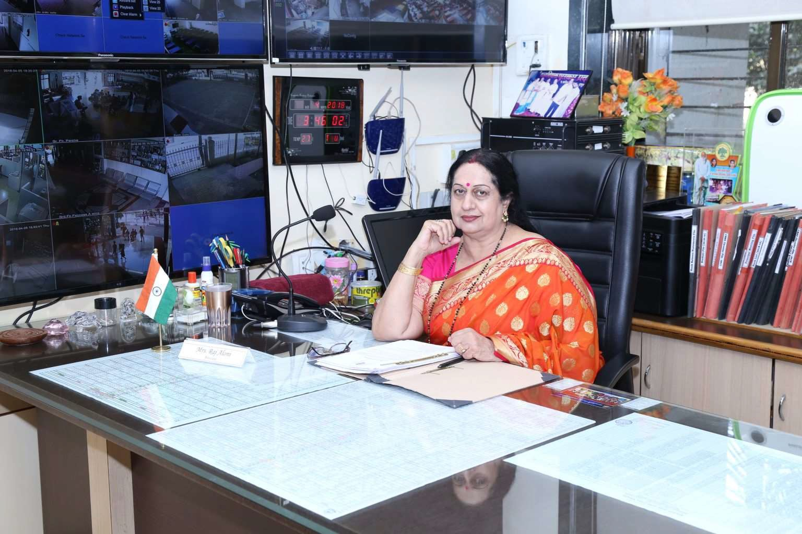
MY PRINCIPAL
Mrs. Raj Aloni is the Principal of our school. She
is the proud recipient of the prestigious
“Maharashtra State Best Teacher’s Award” for the
Academic Year 2005-2006, received at the hands of
Honorable Education Minister Mr. Vasant Purke.
She had earlier been awarded the “Best Teacher’s
Award” for the Academic Year 2002 by The
Muslim Council of India” for her distinguished
service in academic and social development. Our
Principal is able, highly qualified and hard
working. She is very noble and honest. She takes
great interest in her work. She is very kind and
warm hearted and thus very approachable and
friendly towards the students. She is the kind of
mentor and guide that every student wishes to
have in their life. Her academic excellence as an
extraordinary teacher, has won her many prizes in
Science exhibition for 11 years at ward and
regional level and on 4 occasions went up to State
Level. There is no replacement for this Principal
for she is the Best principal of our Best School!.

Slide 7
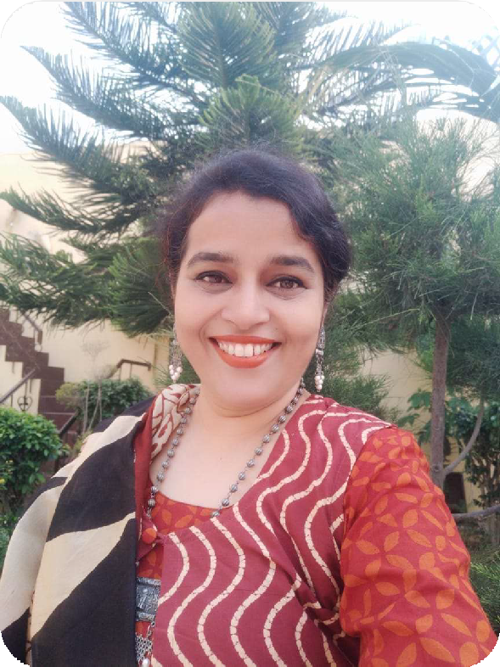

My Class Teacher
A teacher is a person who plays a pivotal role in molding a student’s life. My class teacher’s name is Satinder Kaur. She teaches us Social Science. She knows that our boring part of SST is History so to make us remember everything she makes her lessons interesting. She explains all our doubts very patiently even if some of us may have them repeatedly. She is very calm and is very encouraging towards all the students. She motivates the students to keep trying and learning even if they do not show immediate results. She explains things in simple and clear manner. She is gentle and soft-spoken. She is always ready to help her pupils. She always wants us to be disciplined and tidy. She makes her teaching interesting with the help of videos, charts etc. and due to her good qualities students always praise her and hold her in high esteem. I always take care to do well in the class and try to be like her. I am proud of my class teacher.

Slide 8
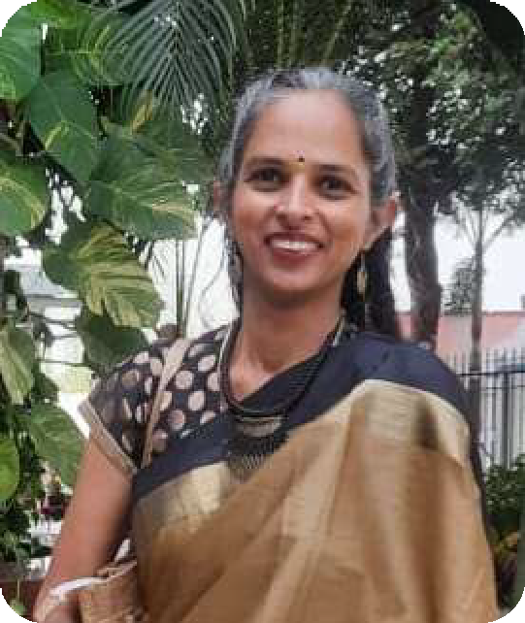

My Subject Teachers
An English teacher is responsible for ensuring that students learn proper grammar, writing, and reading comprehension. My English teacher is Dipali Patil. Everybody just loves the way she teaches. She is gentle and soft-spoken I have never met a person with such fluency in my lifetime. She focuses on our basics and believes that an individual must have a strong fundamental concept to grab advanced knowledge quickly. She likes to explain the lessons by using real-life examples which make it easier for the students to understand. She is very patient with us and all our doubts. She not only teaches us things which are in our syllabus but also encourages us to read books and articles from the library so that we could gain additional knowledge. I am glad that Dipali Patil is my English Teacher.

Slide 9
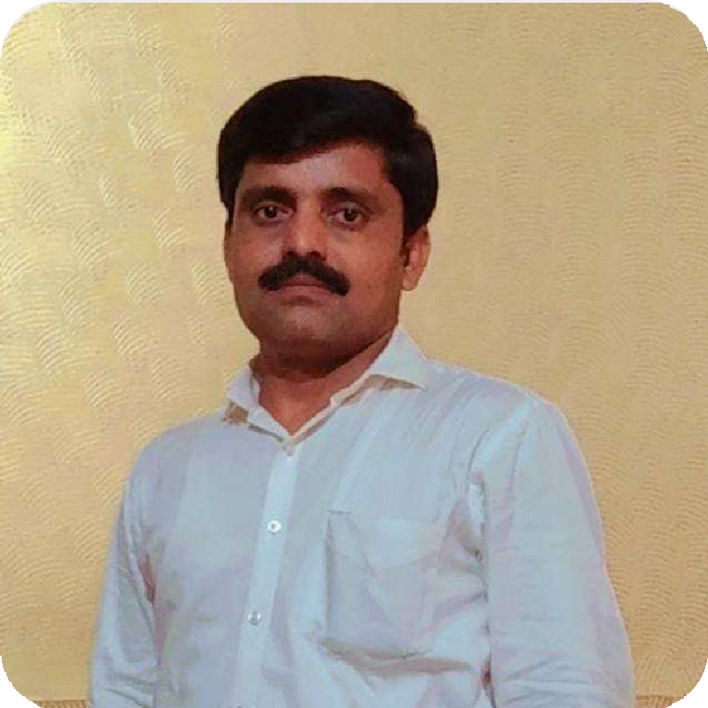

Marathi
My Marathi sir is Yogesh Patil sir I love my sir and I think that his is the best sir in this whole world I love his teaching method his speaking style and I can understand very easily the chapter when his teaches he teaches in very easy way and all understand it and every time he takes revision at least 3 to 4 times of letter and grammar I love my Marathi sir

Slide 10
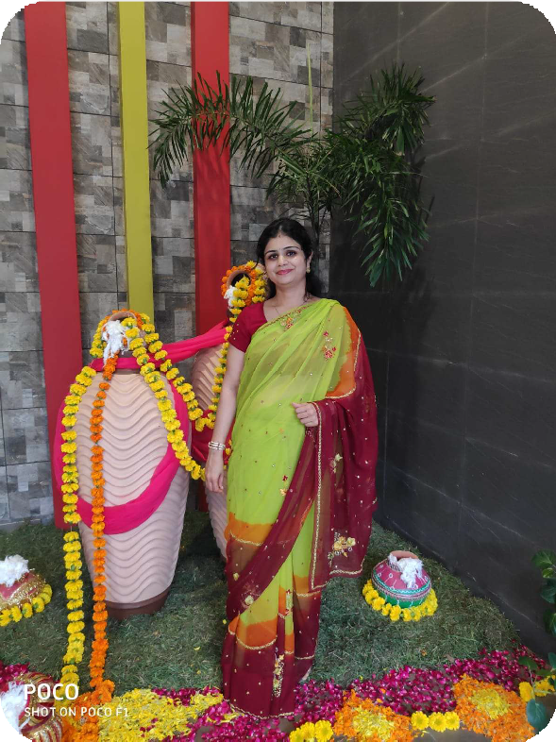
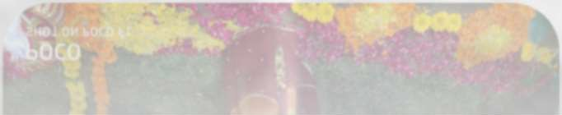
Mathematics
A math teacher is someone who inspires their students to look beyond the pages of the textbook to become problem solvers and critical thinkers. And my Mathematics teacher Ms. Sheetal Jain does exactly that and more. She has made Math simple for us by giving us quicker ways to do problems. She also works out the problems on the board/book which makes it easier to learn. When it comes to Math we are visual learners and we need a detailed explanation. In addition, she explains everything clearly and is always willing to help her students. Ms. Sheetal has positively impacted my opinion on education because she is one of the few exceptional Math teachers I've had. Ms. Shweta's simple teaching method gave me the strategies to be successful in solving math problems. She also wouldn’t hesitate to help her students whenever we are confused. Overall she is a great teacher and pleasant person as well.

Slide 11
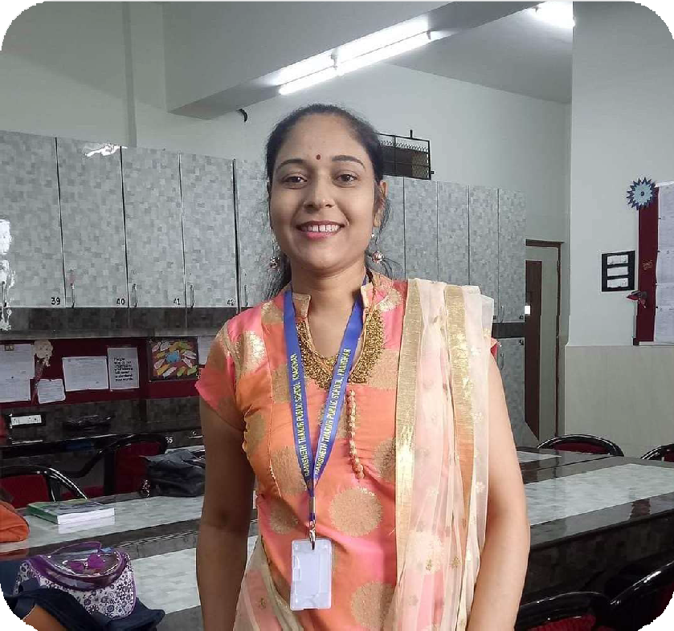
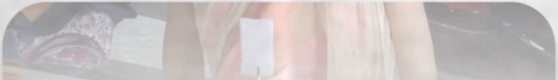
Physics
Mrs. Dipali Wani is my Physics teacher. She is someone who realizes that among the most valued and significant roles of a science teacher is to help a student understand a body of information and the processes of scientific investigation. I was first scared as he looked strict to me but after attending his classes I got to understand that he is very calm and humble and very patient with his students. He poses real world problems to us based on the concepts taught in class and is highly appreciative when we are able to answer those or even make an effort towards its resolution. His encouragement and motivation and simple manner of teaching has made even the difficult subject like Physics very understandable and interesting to us. His teaching methodology is very interactive and thus ensures all students participate in the learning process. I am very happy to have as my Physics teacher.

Slide 12
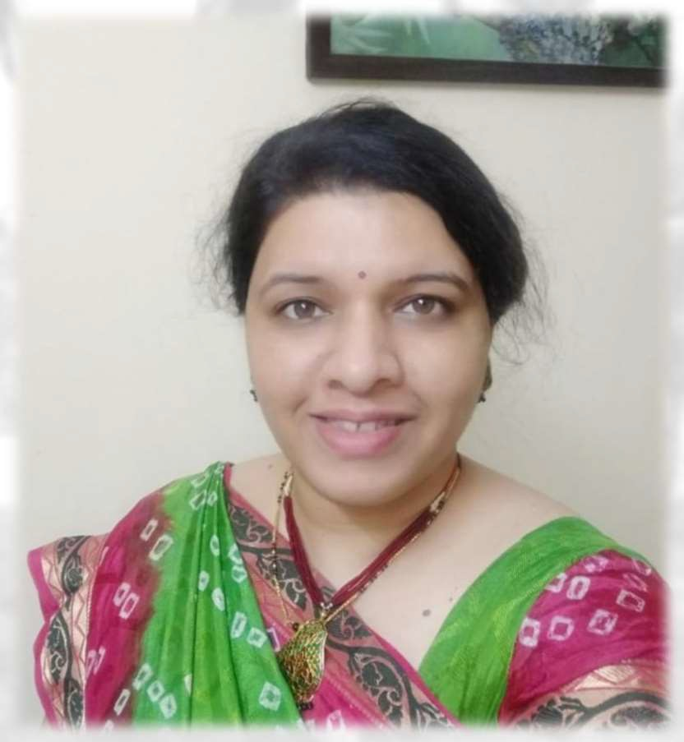
Biology
Ms. Madhura Joshi is our Biology teacher. Her approach towards teaching this Life Science is very lively and engaging. She goes beyond the basics of biology to impart specific wisdom to us students. Her lessons are interspersed with discussions from around our surroundings that relate to Biology and biological systems. This helps us in deeper understanding of the subject and increases our curiosity to know more about the subject. She is a teacher that makes Sciences interesting along with being informative. She ensures that we understand the topics so that we are able to observe our surrounding environment and relate the concepts to reality. Her teaching has only helped us grow more inquisitive and eager in our learnings of the science and I am very happy to have such a teacher in our school.

Slide 13
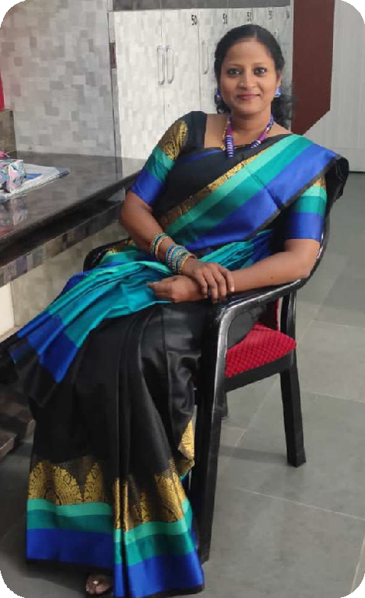

Chemistry
My Chemistry teacher is Ms. Rebhika name is very dangerous but she is very good and polite teacher . Learning chemistry with her is like a fun science exercise with loads of experiments and activities. She is a highly knowledgeable instructor yet very kind and humble in her approach towards teaching us this science subject. All the complex properties of matter become easier to learn and understand with her simplistic way of teaching and breaking down complex concepts into simpler topics. She regularly talks about the real life scenarios about chemicals, labs, factories and thus makes it easier for us to grasp important concepts about this subject. She is very friendly and approachable and is extremely patient with all our doubts and questions. Having her as our Chemistry teacher is a boon and we are very happy with that.

Slide 14
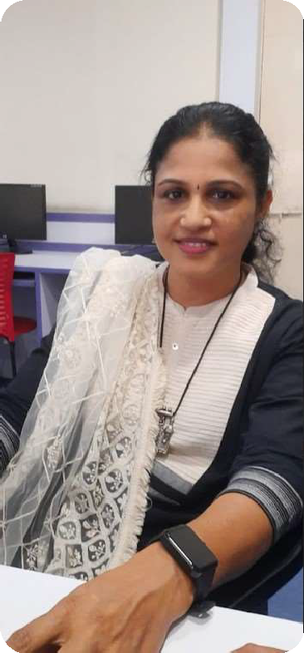

Data Science
Ms. Lekha Mhatre is our Data Science teacher. DS is such a relevant subject in today’s digital age and having her as our teacher is an assurance that we are learning from the best. She teaches us with utmost detail and expertise. Her classes begin with an IT related game and gets us going immediately. Her approach towards teaching this subject is very application oriented and thus keeps us on our toes always. She speaks about real world applications in her lessons and helps us understand the application of classroom concepts to real life problem solving. The practicality of her teaching wants us to go beyond the basics and explore more about the topics. This helps us in deeper understanding of the subject and increases our curiosity to know more about the subject. Her kind and humble nature makes us want to do good in the subject and make her proud of us. We are glad that we have such a wonderful teacher at our school.

Slide 15
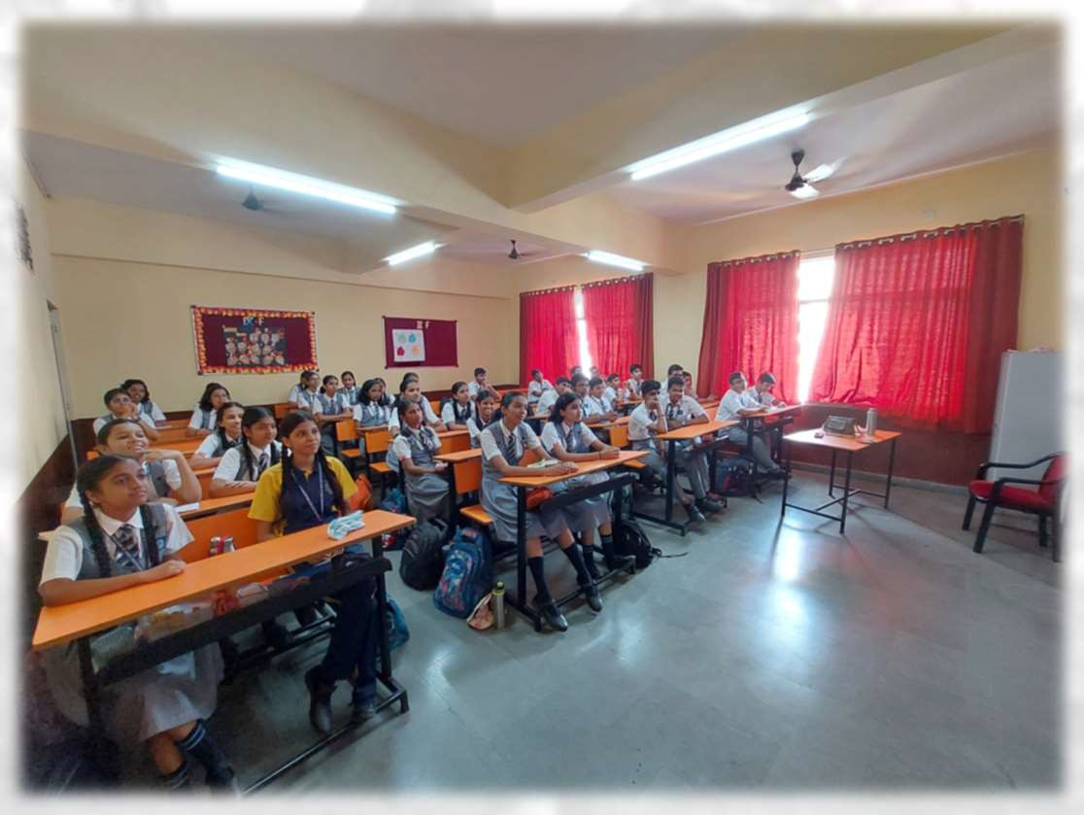
MY Class
School is another home for children and every student loves their class. Yes, I am talking about Ramsheth Thakur Public School, Kharghar! One of the best schools in Kharghar. I study in class 9-F. My class has a total of 30 students. During lockdown, we see each other only online, but yet our teachers make sure that we all classmates are interacting and participating in the classes as we would normally do in the physical scenario. All the students in my class are from varied backgrounds and therefore bring different perspectives to the group. All the students are very friendly and well-mannered. Interacting with my classmates provides me with an opportunity to learn through exchange of information and understanding different viewpoints. I look forward to meet with my class post lockdown

Slide 16
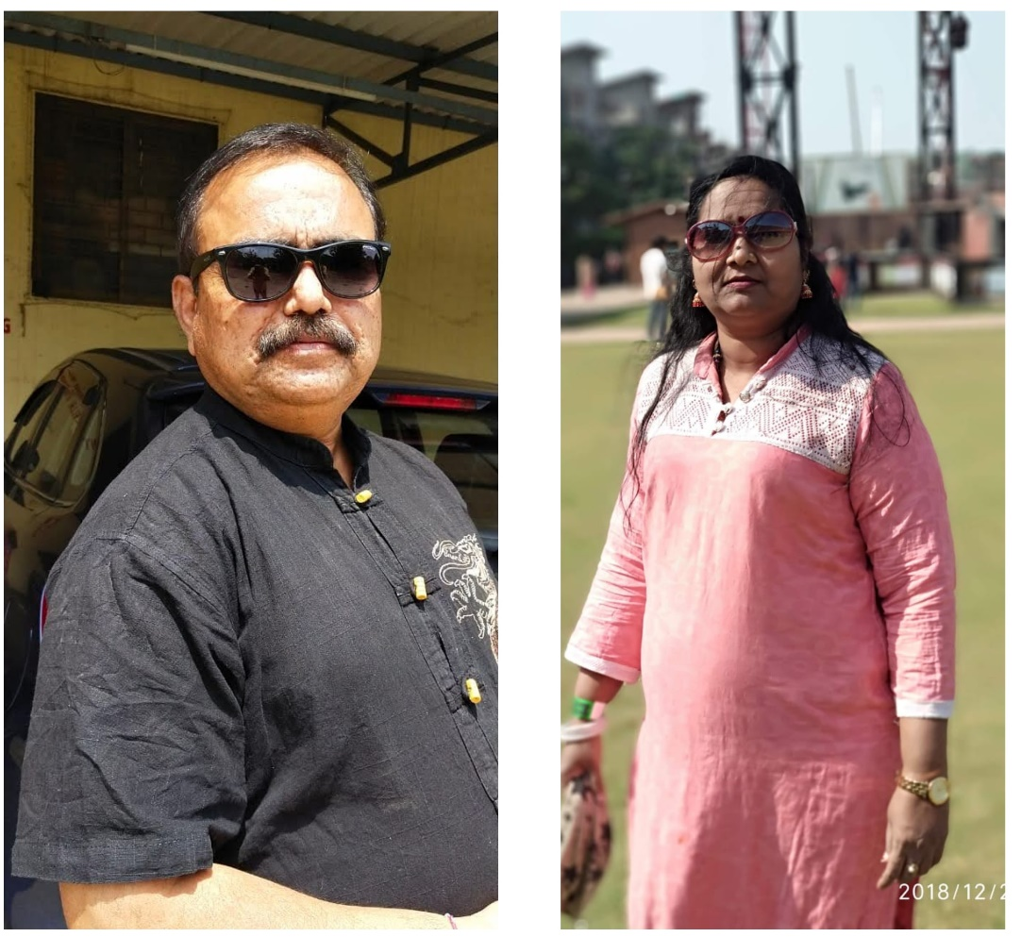
My Parents
My parents are my superheroes. We can never deny the role and value of parents in our life. My father’s name is Mahadev Pawar and my mother’s name is Swati Pawar . They are standing beside me in my every walk of life. My hero is my father. I completely adore this silly side of him when he is with his loved ones. He tries his best to fulfill all our wishes but also maintains the strictness when the need arises. He has always kept a very safe and open home environment. He is hardworking and also helps the needy. My mother is my teacher, best friend and my Wonder Woman. My mother encourages me to improve my all-round skills and studies. She is very much concerned about my health and always makes sure that we eat healthy food. My mother always helps me in my school homework and school tasks. I am proud of my parents and I love them a lot.I think my parents are the best parents in this world

Slide 17
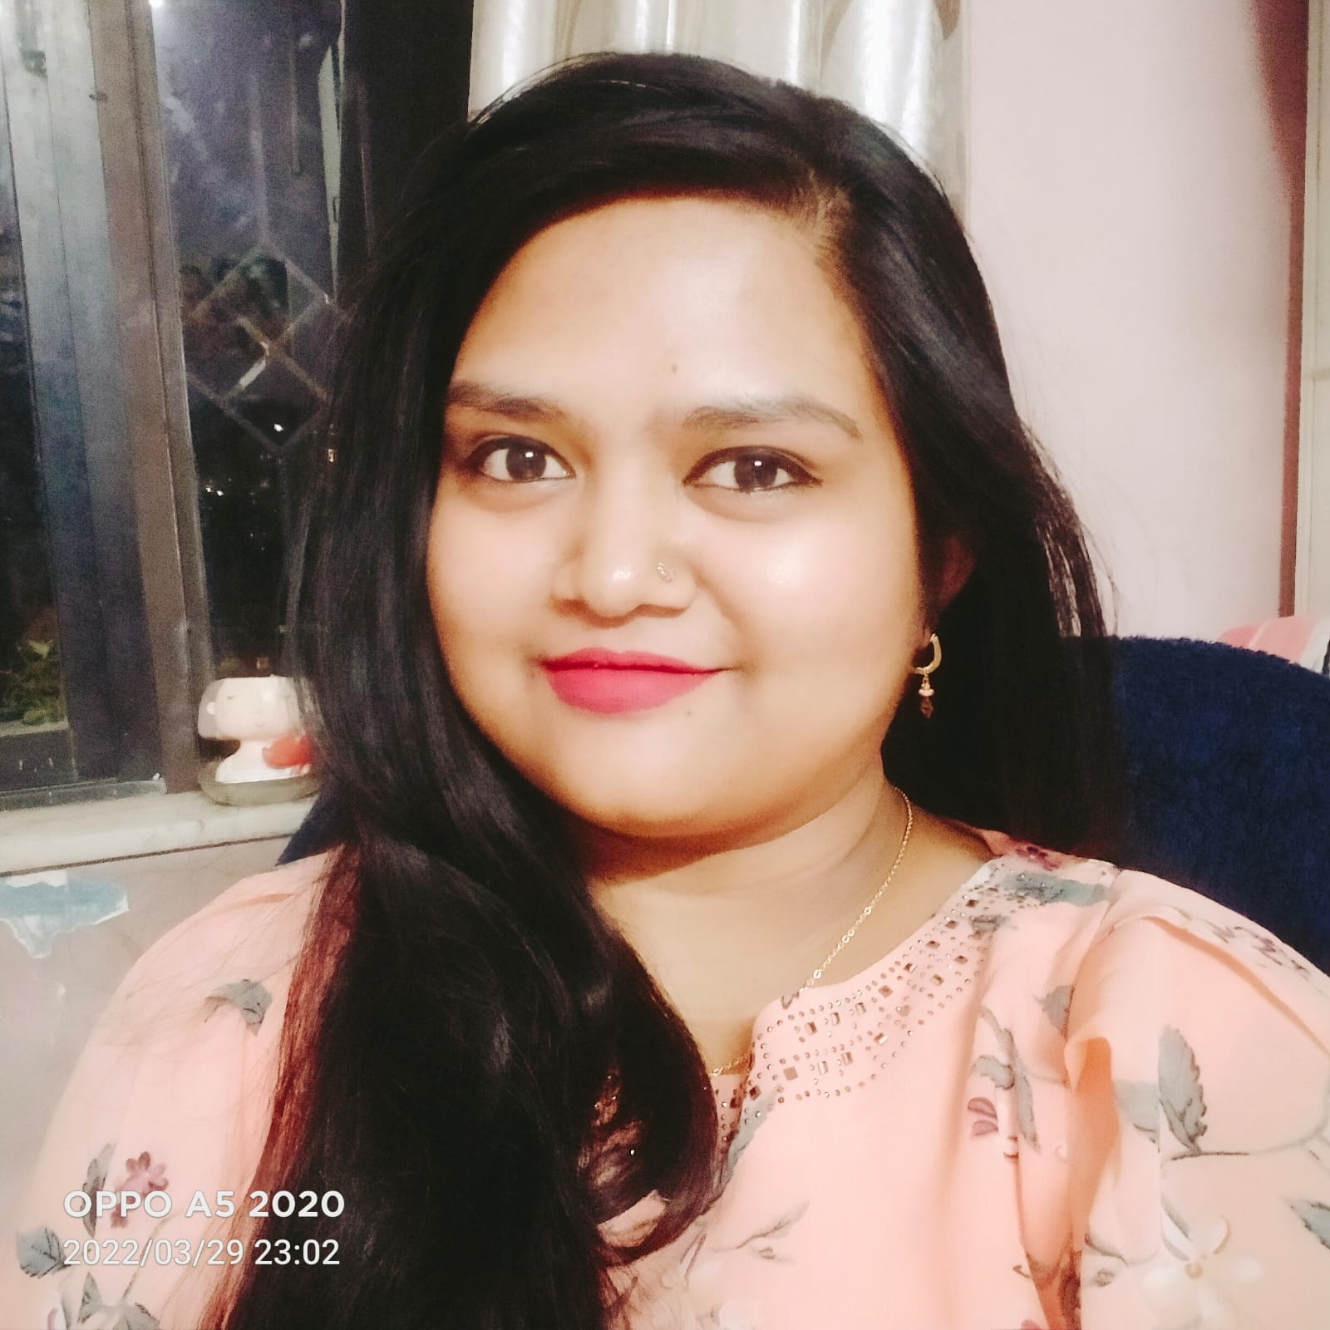
My Sister
Sisters are a blessing for everyone in this world. My sister’s name is Anuja.Katare . She in 3rd Year . Me and my sister are study in the different study platform .But at home, we eat, and study together. She is adorable, sweet hearted and playful. Like all siblings, we also fight but then we also quickly patch up and play with each other. Though we keep fighting, I cannot live without her. She is creative in drawings and coloring. She even tries to help around the house by tidying her toys and arranging her books. When I first found out that I’m a big sister, I couldn’t contain my happiness and kept remembering playing with her all day when she was an infant. I love her a lot. My Sister is the best gift given by god.

Slide 18
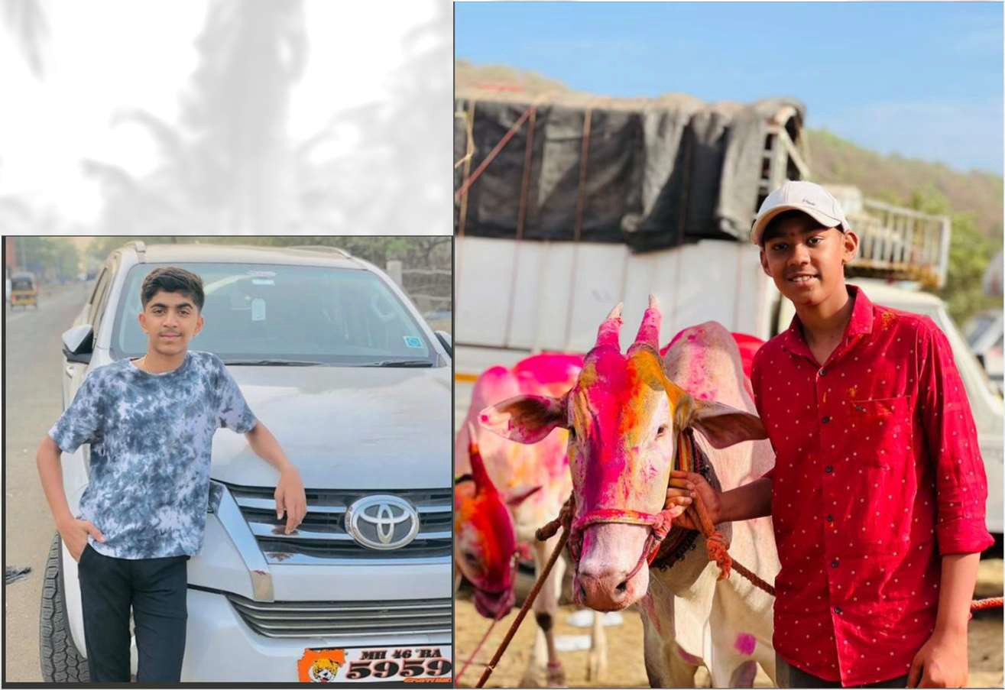
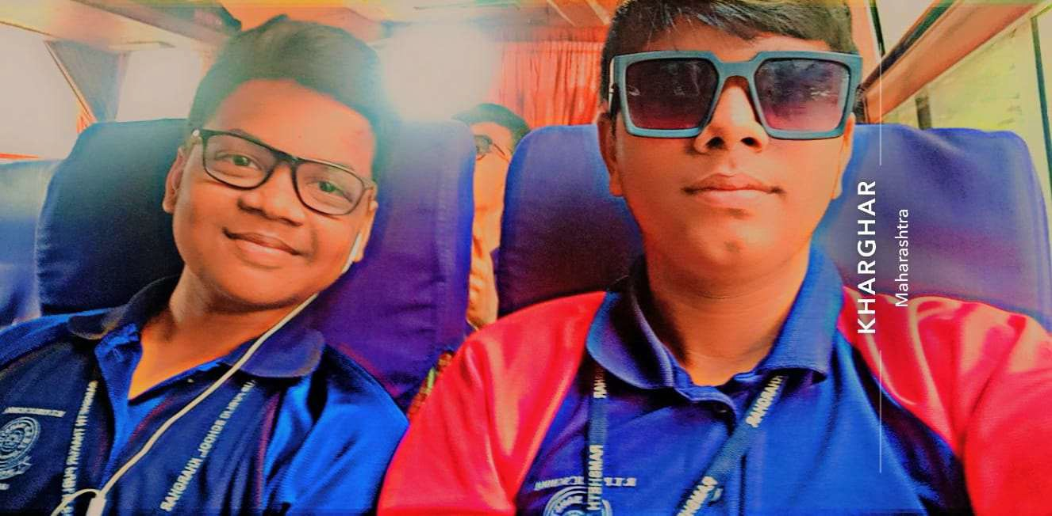
My Friends

Slide 19
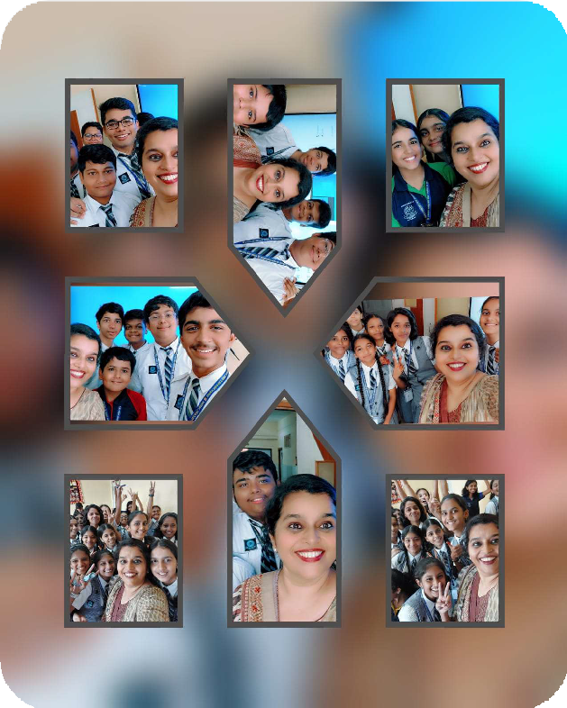

My Classmates
The world appears to be gloomy in the absence of a true friend. The lockdown has actually reminded us of how important our friends and classmates are. Not being able to go to school and meet with your friends and classmates is a big drawback that we are faced with. Learning in a classroom with other students helps us in exchange of knowledge and information. Though we are now learning to do that even in the virtual world, the true essence of teamwork and camaraderie lies in the classroom interactions with our classmates and on the playgrounds when we pay with our friends. We hope to see all of them again soon.

Slide 20

My Ambition/Career
Everyone dreams of something while growing up. We all have dreams and wishes when we are little, which help shape up our ambitions as we grow up. Ambitions lead us to a definite aim in life. Furthermore, they help us focus on our goal no matter the cost. It drives us to do better in life. The ambition of any person’s life usually depends on their choice and interests. I aspire to be a Coding Coach I used to play cricket when I was young, and this would keep me occupied for several hours. Even now, when I am Typing code The teachers in my school are so knowledgeable and yet so kind and humble that it has only strengthened my wish to become a teacher further. Mathematics being my favorite subject that is the subject I would like to pursue further for my career. My goal is to carry the legacy forward of my teachers who are not only working hard towards imparting us the best knowledge but also ensuring that we shape up as good human beings.

Slide 21
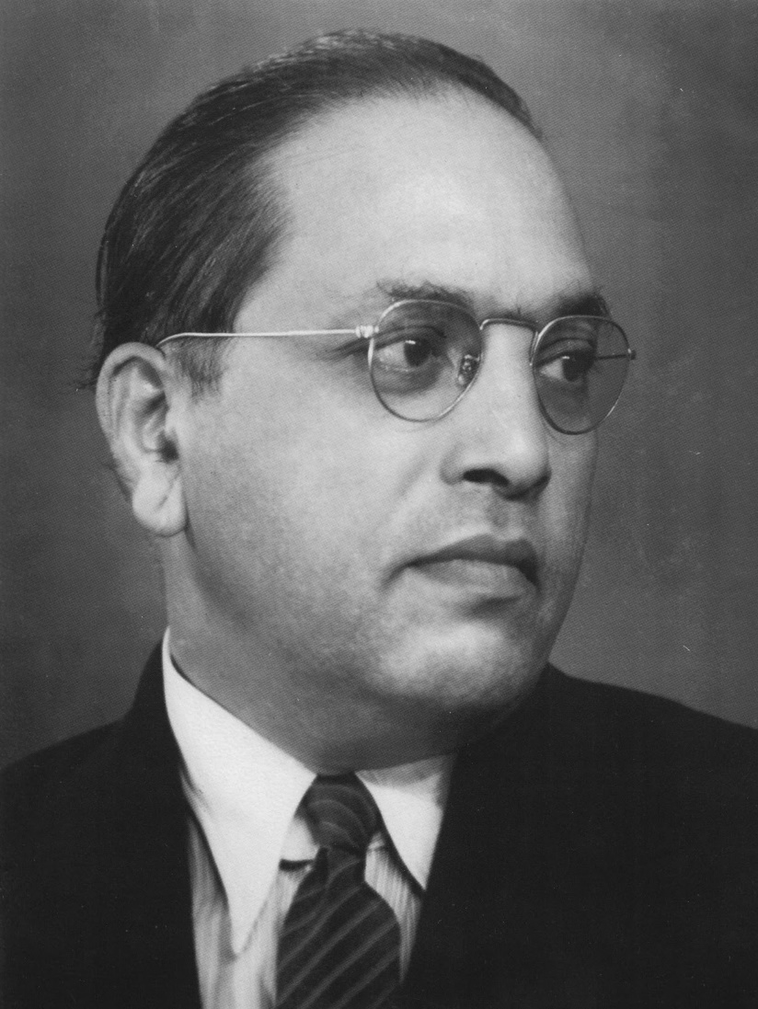
My Role Model
Every one know who is Dr BR Ambedkar was a notable personality in India. He was a jurist, social reformer, economist, and prominent politician. He worked against social discrimination in India and fought for the emancipation of the Dalit community. His father was an army officer, Ramji Maloji Sakpal.

Slide 22
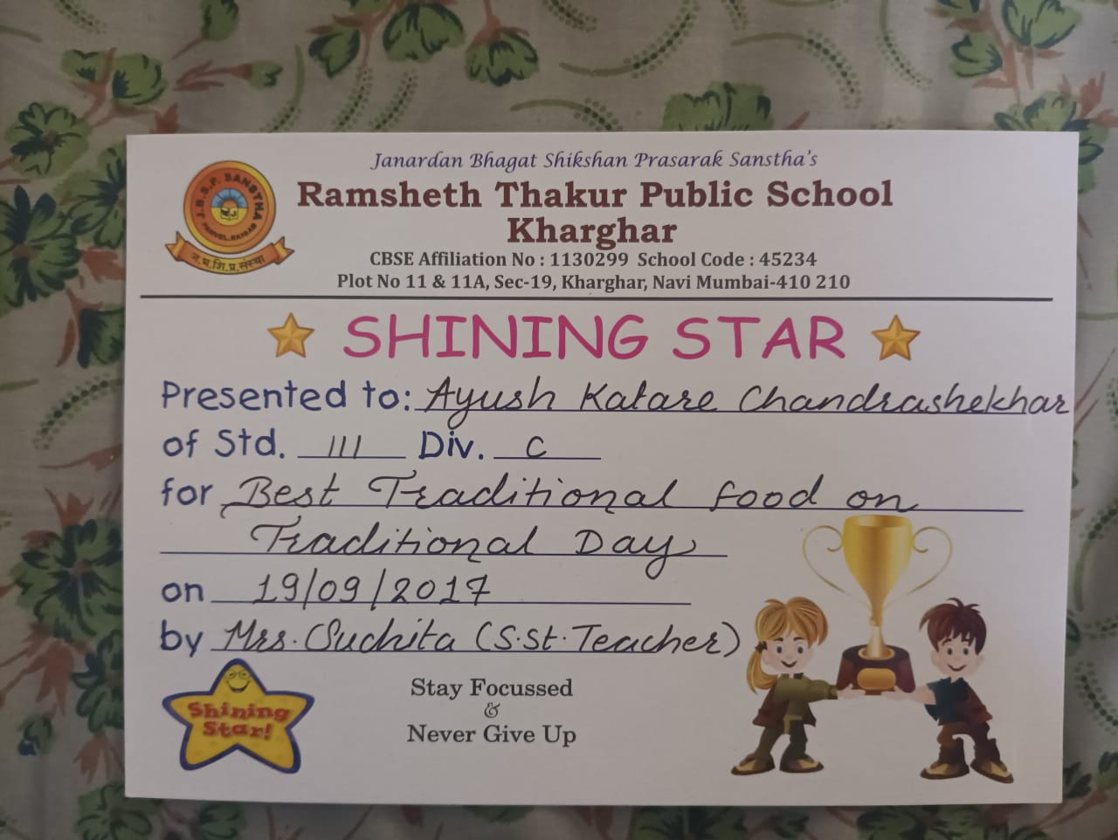
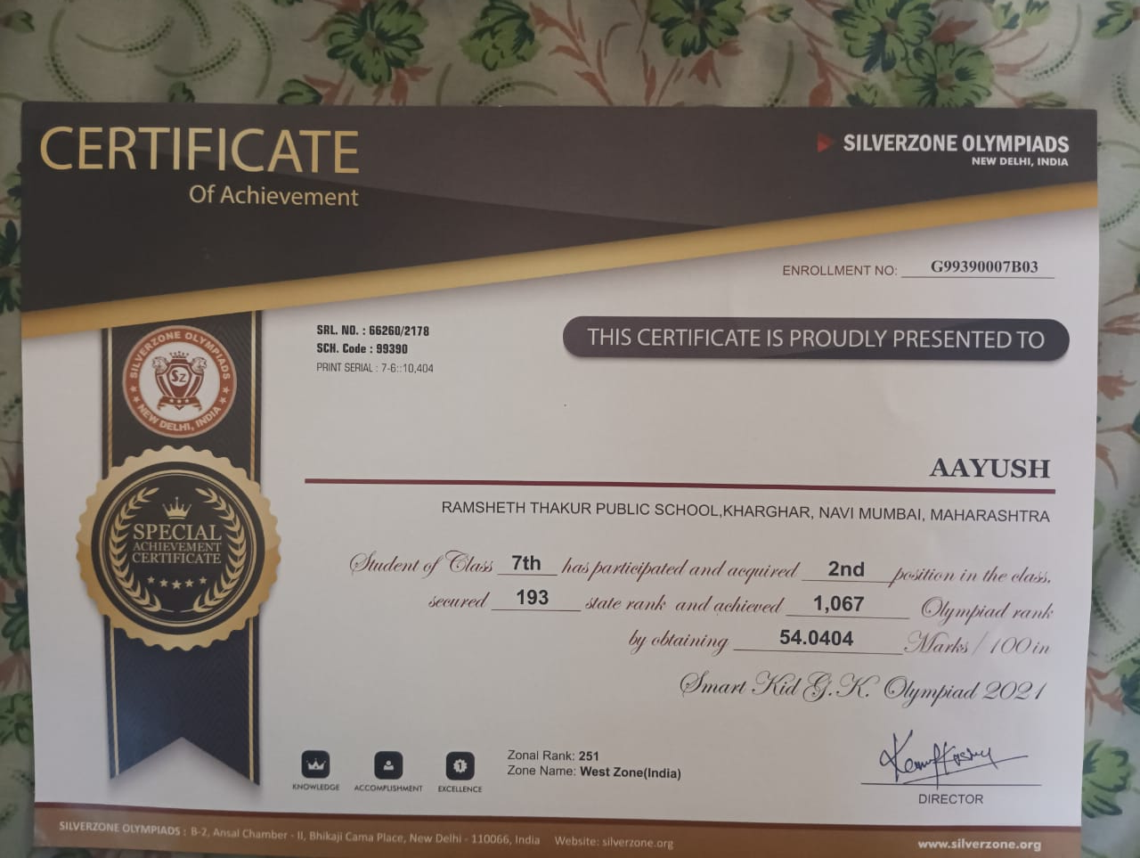
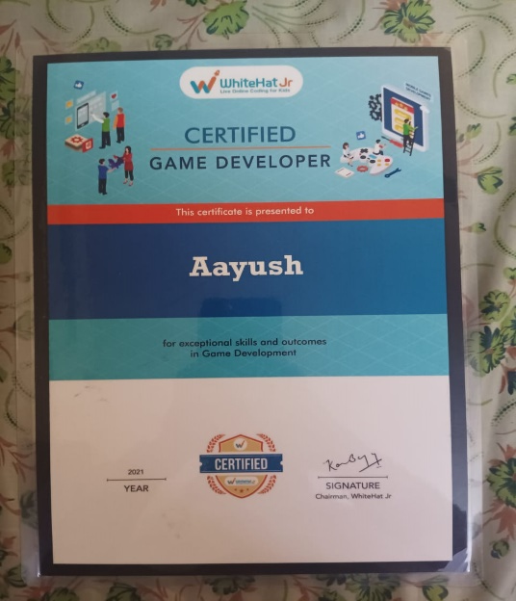
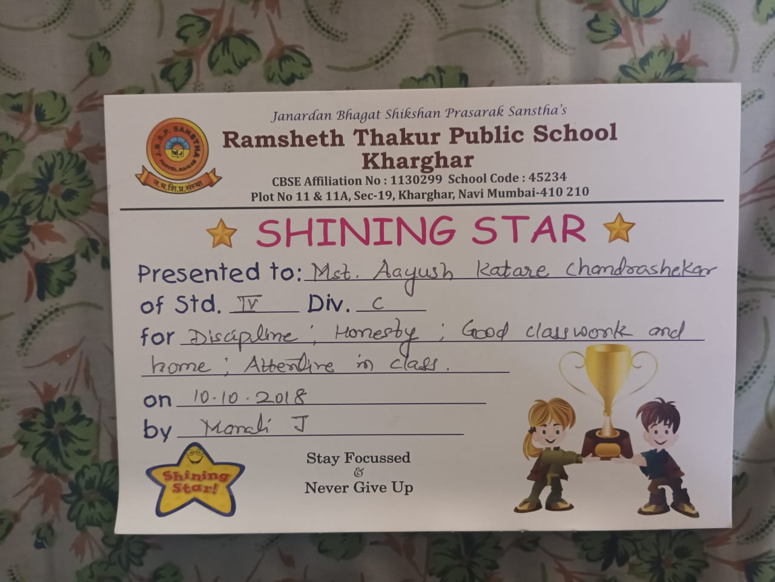
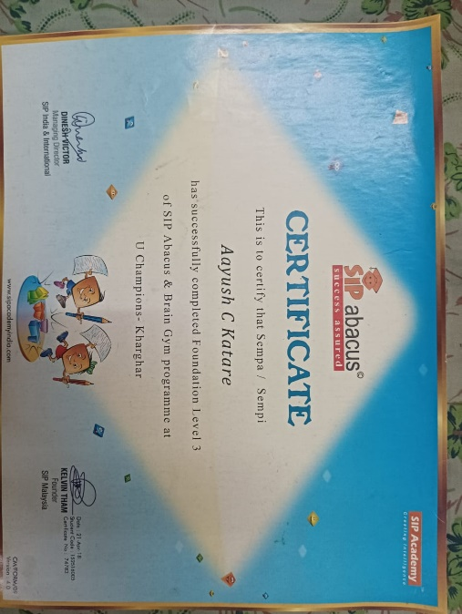
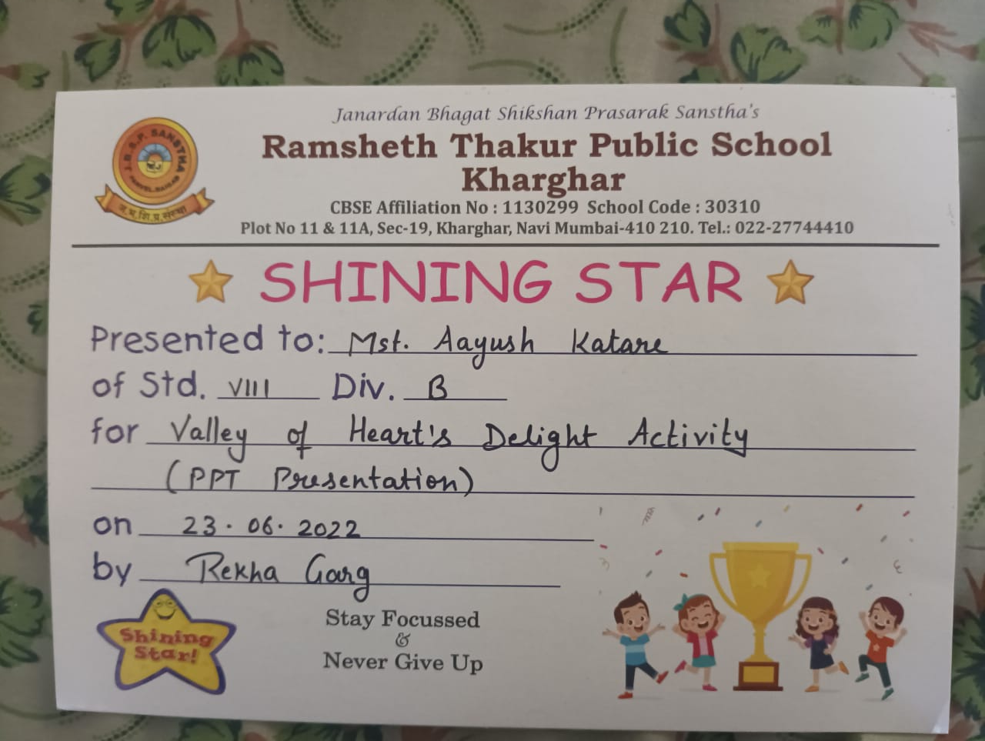
Achievements

Slide 23
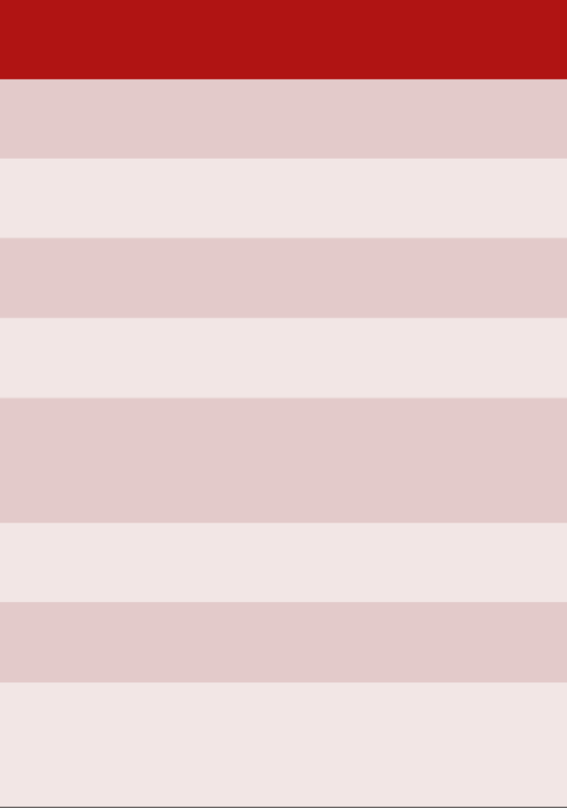
Teachers Remark
Name | Remark
Satinder Kaur
Deepali Patil
Yogesh Patil
Shital Jain
Madhura Joshi
Rebhika
Dipali Wani
Lekha Mhatre

Slide 24

APJ Abdul Kalam, his achievements and about his renowned book 'Wings of Fire '. (English)
He was such a down-to-earth person in spite of being an extremely successful and distinguished scientist. He was known as the Missile Man of India. He was a very simple person with a simple lifestyle. From a small boy growing up in Rameswaram, to becoming the country’s 11th President, his life has been a tale of extraordinary determination, courage, perseverance and the desire to excel. His focus and greatest ambition of finding ways to transform India into a developed nation is the legacy that he has left behind for the younger generation. He was honored with several prestigious awards including India's highest civilian honor "Bharat Ratna" in 1997. We both also share the same birth date. His life journey and his achievements are an inspiration for me to focus on my goals and achieve my dreams.
In the autobiography, Kalam examines his early life, effort, hardship, fortitude, luck and chance that eventually led him to lead Indian space research, nuclear and missile programs. Kalam started his career, after graduating from Aerospace engineering at Madras Institute of Technology, at Hindustan Aeronautics Limited and was assigned to build a hovercraft prototype. Later he moved to ISRO and helped establish the Vikram Sarabhai Space Centre and pioneered the first space launchvehicle program. During the 1990s and early 2000, Kalam moved to the DRDO to lead the Indian nuclear weapons program, with particular successes in thermonuclear weapons development culminating in the operation Smiling Buddha and an

Slide 25

Social Science Topics G20 Summit
The G20 or Group of 20 is an intergovernmental forum comprising 19 sovereign countries, the European Union and the African Union. It works to address major issues related to the global economy, such as international financial stability, climate change mitigation and sustainable development

Slide 26
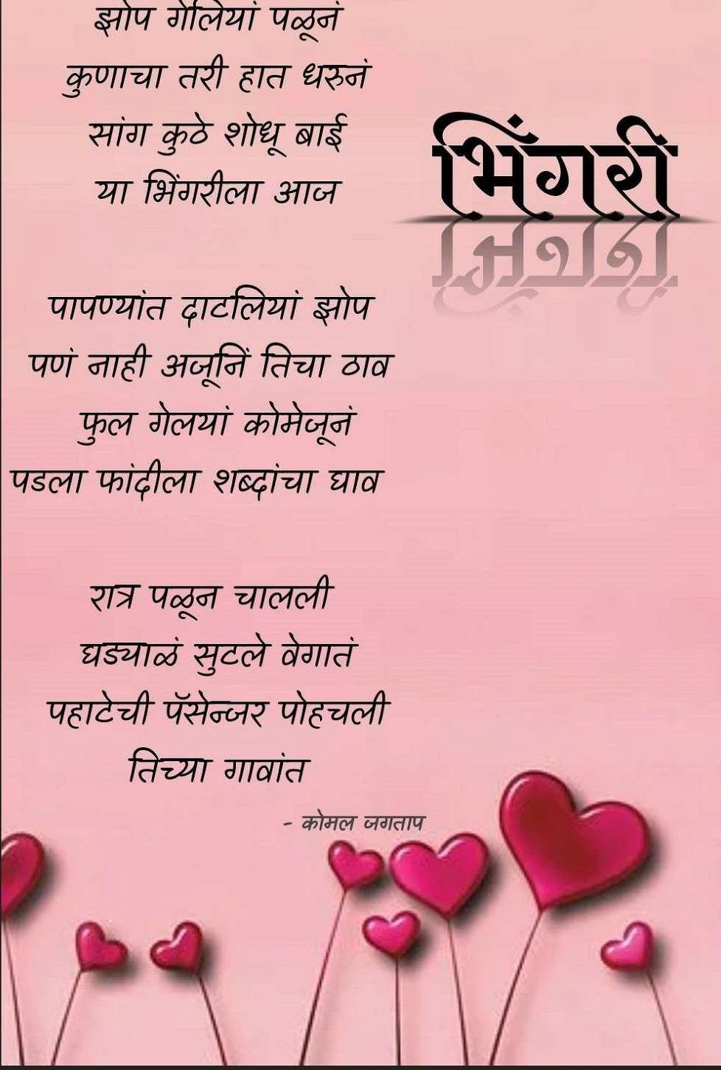
मानवी भावना o!:f c@ करणारी किवता (Marathi)

Slide 27

Thank You

